Slide 1
Greenhouse Gas Effect
And Global Warming

Slide 2
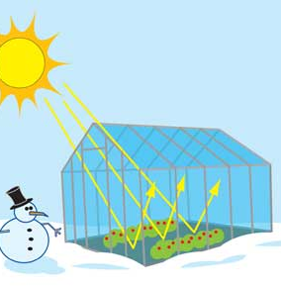
What is a greenhouse?
A greenhouse is made of glass
Has a glass roof and walls
It traps the suns energy inside and keeps plants warm

Slide 3
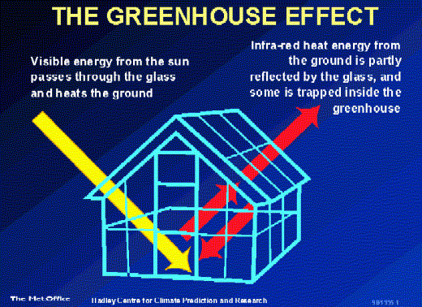
How does it work?
Sunlight shines in and warms up the air inside
Heat is trapped by the glass and can’t escape

Slide 4
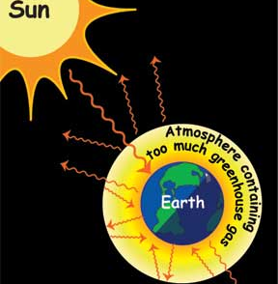
How is Earth like a greenhouse?
The Earth’s atmosphere does the same thing as the greenhouse
Gases in the atmosphere does what the roof in a greenhouse does

Slide 5
How is Earth like a greenhouse?
During the Day
At Night
Sun’s energy reaches the Earth’s atmosphere
Most gets through, but some bounces back to space
Most of the suns energy escapes back into space
But… some is trapped inside by greenhouse gases

Slide 6
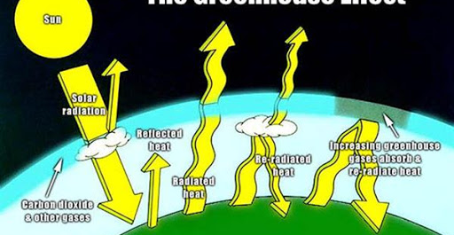
The Greenhouse Effect

Slide 7
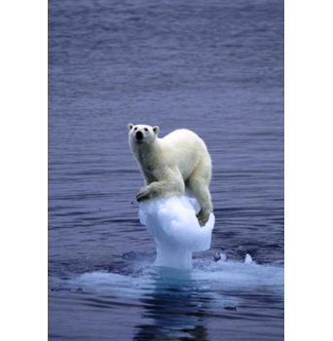
How does this impact us?
If the atmosphere causes too much greenhouse effect…..
Predict what will happen.

Slide 8
Global Warming
Refers to an average increase in the Earth’s temperature, which in turn causes change in climate
A warmer Earth may lead to changes in rainfall patterns, rise in sea level, impacts on plants, animals and humans.

Slide 9
Is the Earth getting warmer?
Yes!
The Earth has warmed by about 1 degree Celsius over the past 100 years

Slide 10
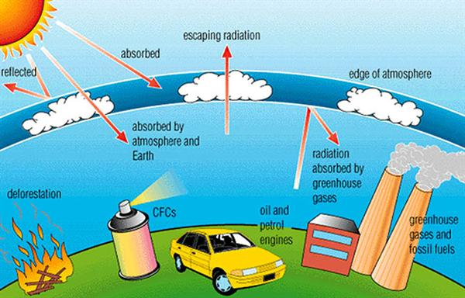
What causes it?

Slide 11
What causes it?
Scientists are still researching global warming, but…
1) Heat from the sun enters earth
2) Most heat is trapped in the atmosphere
3) Carbon dioxide, and other gases from cars and factories trap extra heat
4) Some heat escapes

Slide 12
How can we reduce the greenhouse effect?
!) In groups of 2-3, brainstorm a list of emissions from Earth that are harmful to the environment.
2) Use a Venn diagram to sort the list into:
- factors we (as grade 5 students) can change
- factors are out of our control to change
- factors we both can change

