Slide 1
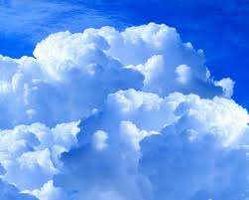
CLOUDS

Slide 2
What is a Cloud?
Clouds consists of millions of microscopic water droplets that form when water vapour in the air condenses on microscopic particles of dust, sea-salt or smoke, as the air cools.
Cloud information is essential for weather forecasting. The type of cloud connects with the weather patterns it brings.

Slide 3
How do Clouds form?
Clouds form when water vapor condenses onto microscopic dust particles floating in the air.
Condensation happens when warm and cold air meet
- This occurs because cool air can hold less water vapor than warm air

Slide 4
About Clouds
Clouds come in many shapes and forms
Some are high in the sky, while others are so low they touch the ground
No matter what size or elevation, clouds form the same way by having water vapor condense around small particles like dust, sea salt, or pollution

Slide 5
What Clouds do:
Clouds provide precipitation, such as rain or snow
They also help retain heat, so it doesn’t escape back into space
On hot days, clouds provide shade

Slide 6
New Vocabulary!
Water Vapor
water that has evaporated from the surface of the Earth
Condense
liquid turns into water or solid ice
Condensation
cloud formation

Slide 7
Cirrus Clouds
Cirrus clouds are found high in the sky. They are thin, wispy, feathery looking clouds that are made of tiny ice crystals. When cirrus clouds are in the sky, a change in the weather will often follow. There is often a sun halo associated with cirrus clouds.

Slide 8
More Cirrus Clouds…

Slide 9
Stratus Clouds
Stratus Clouds form near the Earth’s surface. Their formation indicates that the relative humidity near the ground is high. They are usually flat clouds that cover large portions of the sky. They signal stormy weather. Fog is a result of very low stratus clouds.

Slide 10
More Stratus Clouds…

Slide 11
Cumulus Clouds
Cumulus clouds are seen most often in the summer. They are thick, fluffy, white and have flat bases. They look like bunches of white cotton. They are a sign of fair weather (nice weather).

Slide 12
More Cumulus clouds…

Slide 13
Nimbus Clouds
Nimbus clouds are dark, dense and low. The sky associated with nimbus clouds is usually a uniform dark color. The darkness is due to the large amount of moisture in the nimbus cloud. They almost always signal rain or thunder showers.

Slide 14
More Nimbus Clouds…

Slide 15
Types of Clouds

Slide 16
Types of Clouds
Type of Cloud | Appearance | Altitude
Cirrus | Thin, wispy, and curly | 18,000 feet High- altitude
Cumulus | Puffy and piled up | 6,500 feet Vertical clouds
Stratus | Uniform, flat with thick to thin with ill-defined edges | 6,500 feet Low-altitude
Nimbus | Dark, dense and low | 6,500 feet Low-altitude

Slide 17
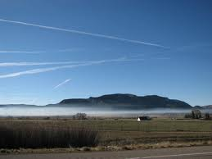
A Cool Fact
The long white tails made by airlines are actually high level cirrus clouds. The are formed when the water vapour (from the engine) freeze into tiny ice crystals. If the “streak” disappears quickly, it suggests that there will be good weather. If the “streak” remains for some time, there maybe potential for a storm.

